Slide 1
TEAM NAME :
MISTER HACKER
PROJECT NAME :
ONE CILCK TRAVEL

Slide 2
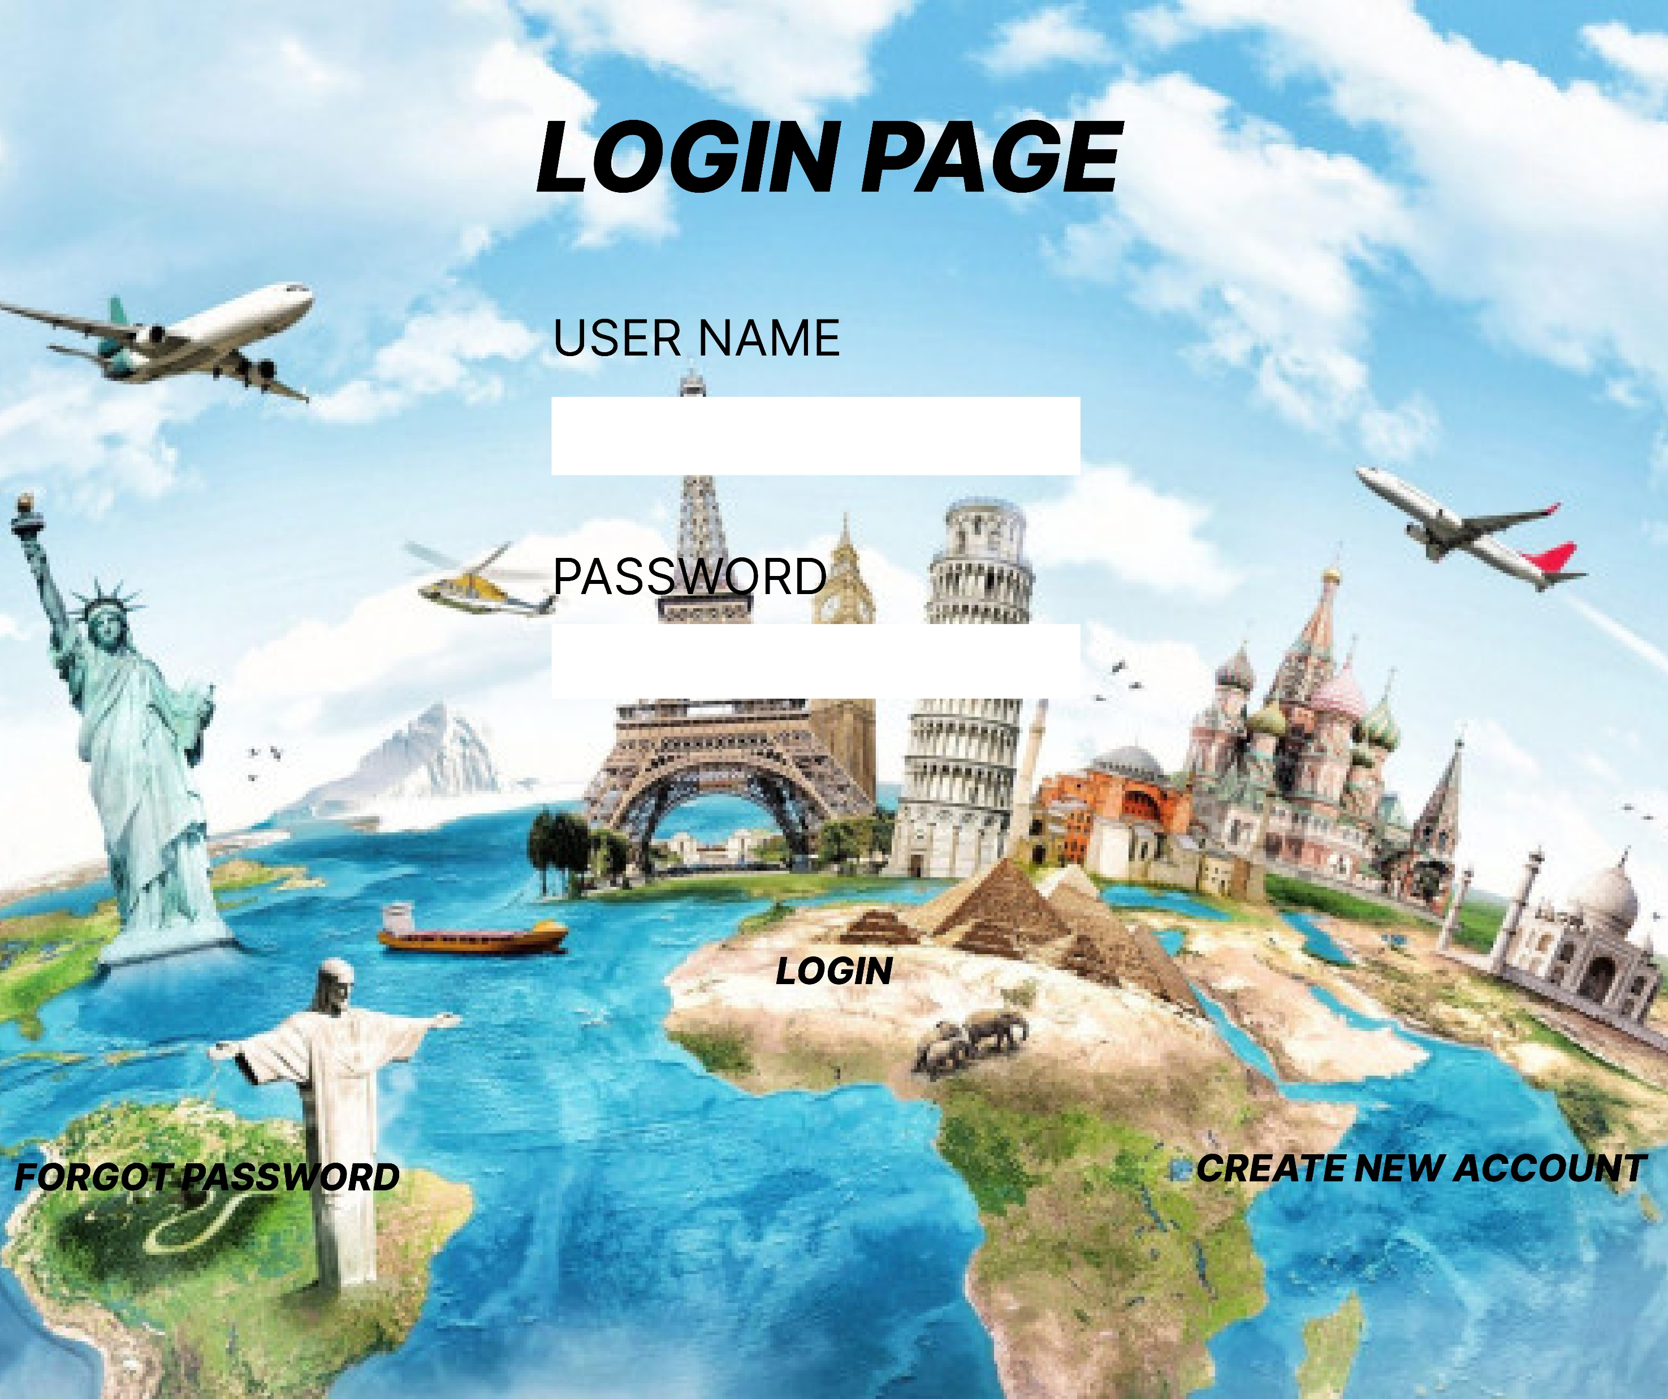

Slide 3


Slide 4
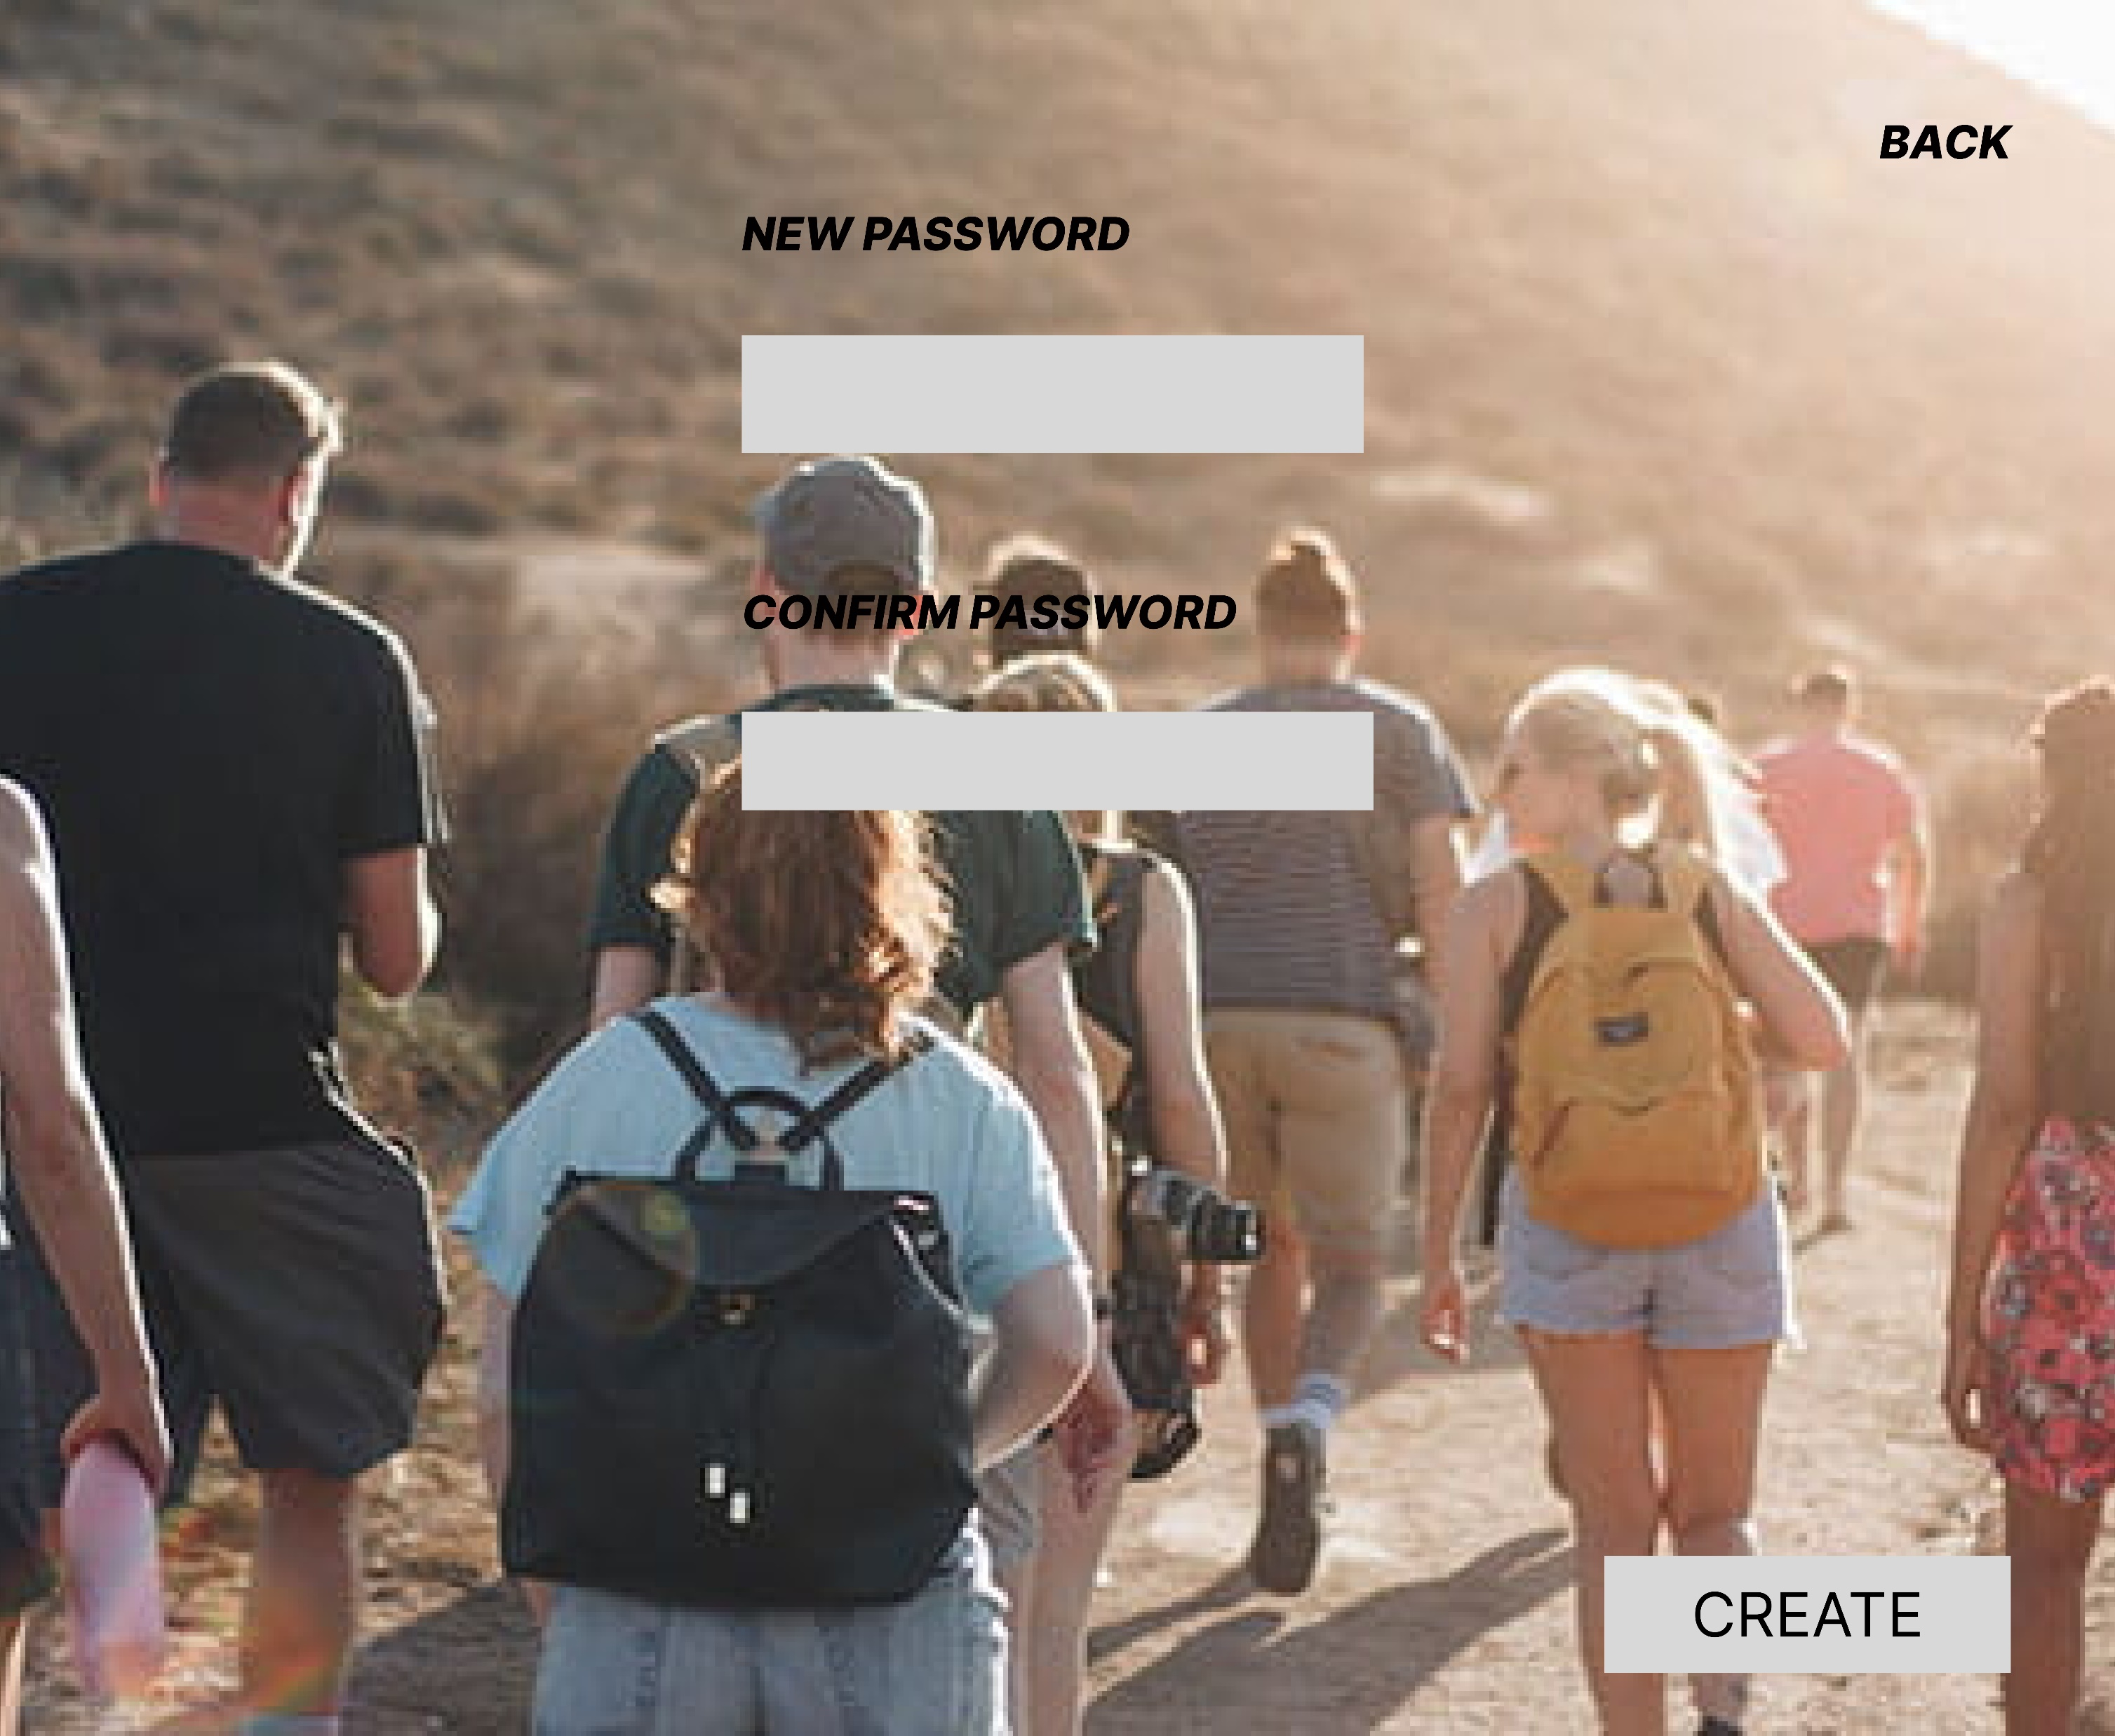

Slide 5


Slide 6
LINK :
https://www.figma.com/file/2NqUni6Lacki06Xefe1aFV/Untitled?node-id=0%3A1

Slide 7
THANK
YOU

